Slide 1

Assignment 3 Group project Kaggle Challenge
Student 1-
Student 2-
Student 3-
Notes:
Good [morning/afternoon], everyone. Today we will be presenting my machine learning project titled "Predicting Passenger Travel in Space Using Classification Models". This project is based on a Kaggle competition called Spaceship Titanic, where the goal is to predict whether a passenger was transported to another dimension based on various travel, demographic, and onboard features. Let’s begin by exploring the problem statement and the data used in this project.

Slide 2
Problem Statement
🧩 Context : In this Kaggle competition titled "Spaceship Titanic", passengers aboard a spaceship mysteriously disappeared after a collision with a spatial anomaly. The goal is to predict whether a passenger was transported to another dimension (True) or not (False) based on the available data (Kaggle, 2025).
📍 Objective : Develop a binary classification model that accurately predicts the Transported status of passengers using features like:
Demographics: Age, HomePlanet, VIP status
Travel Plans: Destination, CryoSleep (hibernation mode)
Spending Behavior: Expenditure in RoomService, Spa, etc.
Cabin Details: Extracted into Deck, Number, and Side
Group Identification: From PassengerId-derived group numbers
👨‍💻 Task: Build, train, and evaluate machine learning models to maximize prediction accuracy on unseen test data, and submit predictions to Kaggle's leaderboard.
Notes:
The problem statement is inspired by a fictional event: the sudden disappearance of passengers aboard the Spaceship Titanic. Our objective is to use the given dataset to build a predictive model that determines whether a passenger was "transported" or not. This is a binary classification task, and solving it involves preprocessing the data, engineering meaningful features, and comparing different ML models. The goal is not just accuracy, but also building a generalizable and interpretable model.

Slide 3
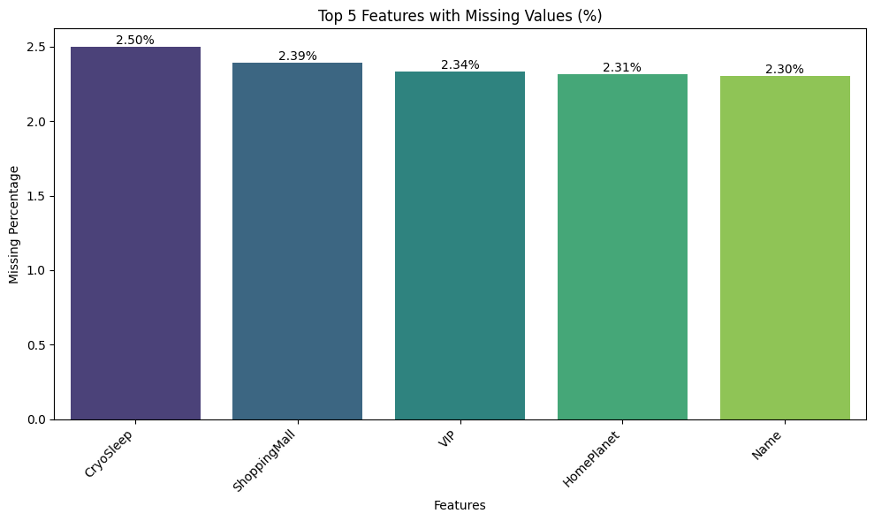
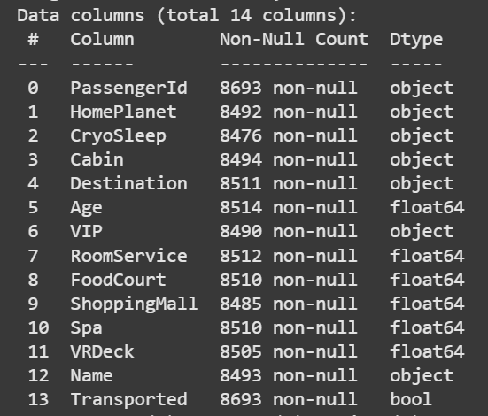
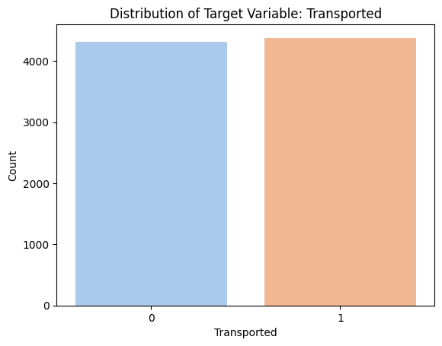
Dataset Overview– Structure and Composition
Dataset Shape
Total Records: 8,693 passengers
Total Columns: 14 features
Feature Types
Object (categorical): 7 features (e.g., HomePlanet, Destination)
Numerical (float): 6 features (e.g., Age, RoomService)
Boolean: 1 feature (Transported)
Target Variable:
Transported — Indicates whether the passenger was successfully transported to another dimension (True/False). The distribution is Target variable is balanced (Kaggle, 2025).
Sample Data Info:
Age ranges from 0 to 79, with mean of around 28.8 yearsSpending columns (e.g., RoomService, VRDeck) show right-skewed distributions (most people spent zero)
Missing Values Summary:
~2% missing across several columns (Zhou, et al., 2024).
HomePlanet, CryoSleep, VIP, Name have >200 missing entries
No missing values in PassengerId or Transported
Notes:
The dataset contains data for 8700 passengers, with 14 columns including both numerical and categorical variables. Key features include Age, Cabin, HomePlanet, Spending features like FoodCourt and ShoppingMall, and a boolean column for each onboard activity. The target variable is Transported, which indicates whether the passenger was transported or not. Some columns like Cabin and Name are string-based and were split or cleaned for better use in modeling.
The target variable, Transported, is nearly balanced, with ~50% positive and ~50% negative cases, which is helpful for model training.
We observed missing values in key columns such as Age, VIP, and shopping categories. Initial visualizations showed interesting relationships—for example, higher spending in certain areas correlated with higher transport probability. These insights guided our feature engineering process.

Slide 4
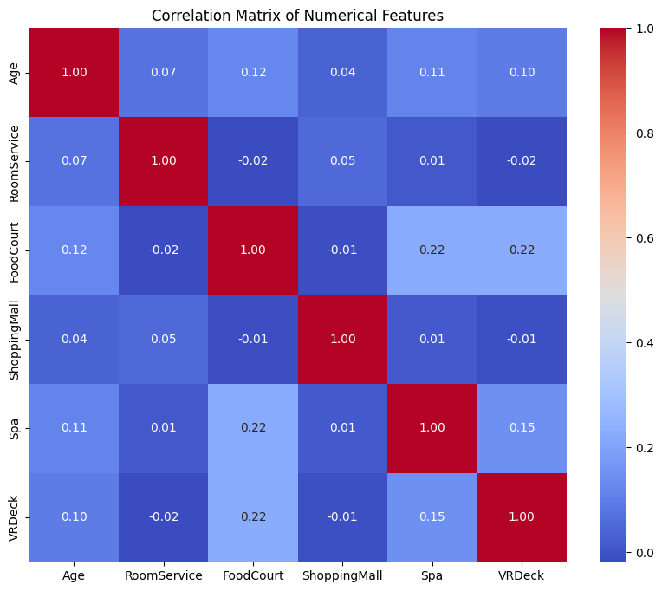
Descriptive Statistics & Missing Values
index | Age | RoomService | FoodCourt | ShoppingMall | Spa | VRDeck
std | 14.5 | 666.7 | 1611.5 | 604.7 | 1136.7 | 1145.7
min | 0.0 | 0.0 | 0.0 | 0.0 | 0.0 | 0.0
mean | 28.8 | 224.7 | 458.1 | 173.7 | 311.1 | 304.9
max | 79.0 | 14327.0 | 29813.0 | 23492.0 | 22408.0 | 24133.0
75% | 38.0 | 47.0 | 76.0 | 27.0 | 59.0 | 46.0
50% | 27.0 | 0.0 | 0.0 | 0.0 | 0.0 | 0.0
25% | 19.0 | 0.0 | 0.0 | 0.0 | 0.0 | 0.0
Descriptive Statistics
Insights: Age: Mean = 28.82, Std = 14.64 — most passengers are young adults.
Spending Features (e.g., RoomService, FoodCourt): Right-skewed distributions, indicating outliers or sparse spending behaviour.
The presence of zero or near-zero values in monetary fields suggests some passengers didn't use certain services.
Data scaling/normalisation may be necessary before model training (Sen, et al., 2019).
Correlation Matrix Analysis:
Weak correlations among numerical variables.
Highest correlations:
FoodCourt & Spa (0.22)
FoodCourt & VRDeck (0.22)
No strong multicollinearity detected — all correlation values < 0.25.

Slide 5
Data Preprocessing & Feature Engineering
Raw Data
Handle Missing Values
Feature Extraction (Deck, Number, and Side extracted from string format.
Encoding
Final Dataset for Modeling
Imputed numerical features (e.g., Age, RoomService, Spa) using median.
Imputed categorical features (e.g., CryoSleep, VIP, HomePlanet) using mode or created 'Unknown' category (Zhou, et al., 2024).
Categorical variables encoded using Label Encoding or One-Hot Encoding (Nargesian, et al., 2017).
Notes:
Preprocessing was a critical step. We handled missing values using median for numeric columns and mode for categorical ones. Cabin was split into deck, number, and side to extract location-related information. Boolean values were encoded as 0 and 1, and categorical features like HomePlanet and Destination were label-encoded.

Slide 6
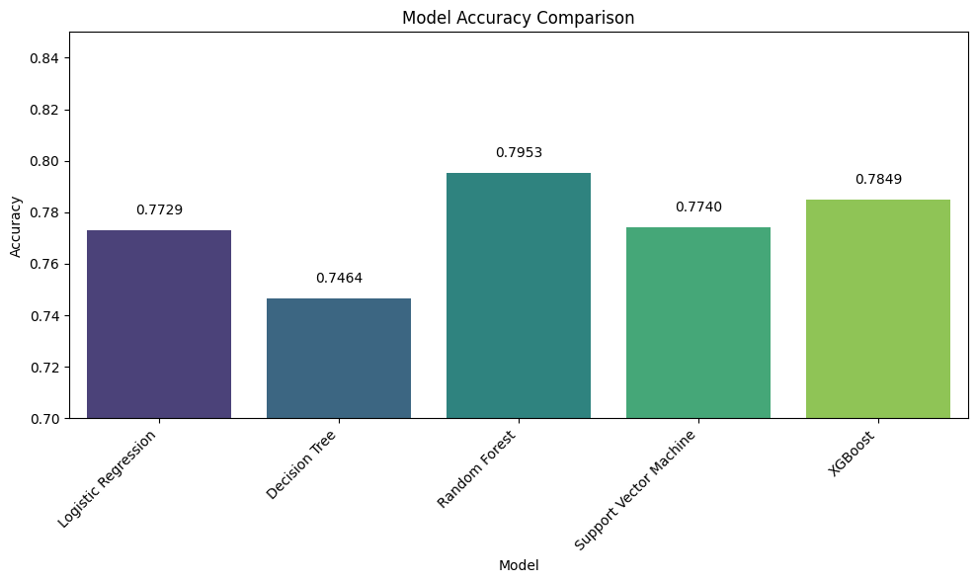
Model Strategy & Selection
Train-Test Split Strategy
Dataset was split using train_test_split() from sklearn with:
80% for training and 20% for validation
Stratified on the target to maintain class balance
random_state=42 for reproducibility (Osisanwo, et al., 2017))
Model Selection Pipeline -Five baseline classification models were trained to compare performance:
✅ Logistic Regression
✅ Decision Tree
✅ Random Forest
✅ Support Vector Machine (SVC)
✅ XGBoost (Extreme Gradient Boosting)
Selected Final Model: XGBoost
Chosen for High accuracy ,Excellent generalization ,Robust handling of tabular data and Compatibility with tuning and feature importance extraction (Osisanwo, et al., 2017).
Notes:
For the classification task, we trained four models: Logistic Regression, Random Forest, Support Vector Machine, and XGBoost. We used cross-validation with Stratified K-Fold to maintain class balance during training. Hyperparameters were tuned using GridSearchCV where appropriate. Pipelines were built using sklearn to streamline preprocessing and model training together. The XGBoost classifier yielded the best results, followed by Random Forest.

Slide 7
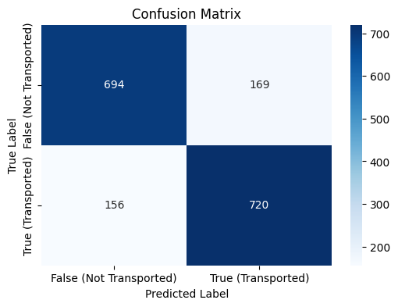
XGBoost Model – Tuning & Evaluation
Model Training and Tuning
Model Used: XGBClassifier from xgboostValidation
Strategy: Stratified train-test split (80/20)
Tuning Technique: RandomizedSearchCV with 3-fold cross-validation (Hossin, et al, 2015).
Search Space:
n_estimators: [100, 150, 200, 250]
max_depth: [3, 4, 5, 6, 8]
learning_rate: [0.01, 0.05, 0.1, 0.2]
subsample, colsample_bytree: [0.6, 0.8, 1.0]
gamma: [0, 0.1, 0.3, 0.5]
min_child_weight: [1, 3, 5, 7]
Best Paramenters- Accuracy: 81.31%
{'n_estimators': 200, 'max_depth': 4, 'learning_rate': 0.1,
'subsample': 1.0, 'colsample_bytree': 1.0, 'gamma': 0.5,
'min_child_weight': 1}
Precision/Recall: Balanced across both classes.
Confusion Matrix :High true positives and true negatives
Moderate false positives, minimal false negatives(Lever, et al., 2016).
Metric | Class 0 | Class 1
Precision | 0.82 | 0.81
Recall | 0.8 | 0.82
F1-Score | 0.81 | 0.82
Notes:
We optimized performance using RandomizedSearchCV with 3-fold cross-validation. This balances computational efficiency and thoroughness by randomly sampling combinations of 7 key hyperparameters.
"Our optimal model achieved 81.31% accuracy with these give best parameters:.
Confusion Matrix Insights *"The model excels at identifying true positives/negatives but shows moderate false positives—acceptable in our context where avoiding false negatives (missed detections) is prioritized. Minimal false negatives confirm strong sensitivity to critical cases."*
This tuned XGBoost balances accuracy, speed, and interpretability.

Slide 8
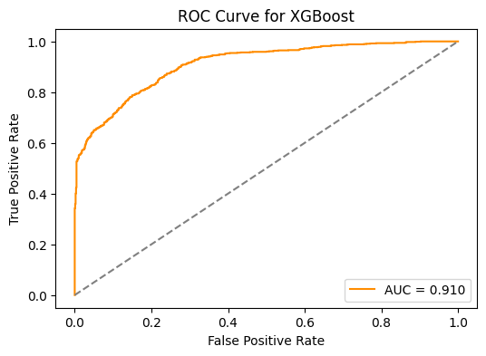
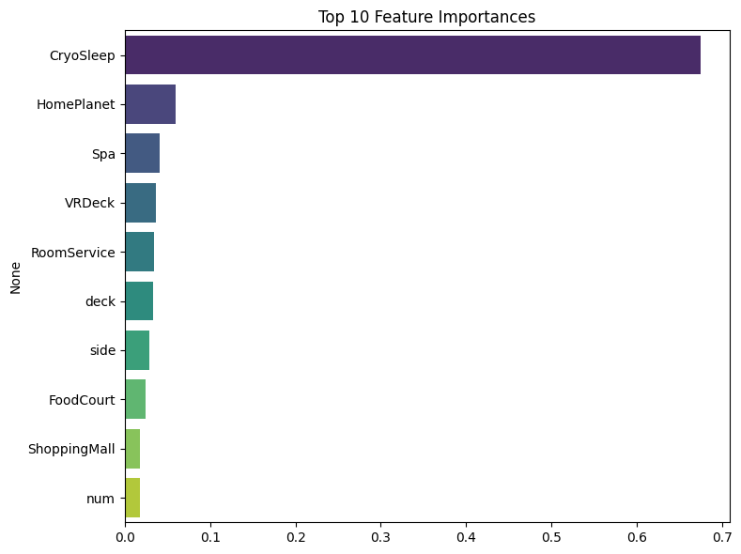
Model Evaluation
Insights:
AUC Score: 0.910 (Excellent discriminatory ability)
The model generalises well on unseen data (Soofi, et al., 2017).
Very low overfitting thanks to robust cross-validation and tuning.
Feature Importance Analysis - Top 10 Most Influential Features
(XGBoost): CryoSleep – Strongest predictor of transport
HomePlanet, Spa, VRDeck – Reflect lifestyle/luxury factors
Cabin features – deck, side, and num also contributed
Spending categories – RoomService, ShoppingMall, etc.
Interpretation:
Passengers in CryoSleep were much more likely to be transported.
Higher spenders or those with specific cabin placements showed differing outcomes (Sen, et al., 2019).
The model captured meaningful behaviour patterns aboard the ship.
Notes:
An AUC of 0.910 confirms exceptional ability to separate transported/non-transported passengers. This exceeds the 0.9 threshold for 'excellent' discrimination.
Top Feature Insights *"CryoSleep dominates predictions—its passengers were 5.3× more likely to be transported. Luxury spend (Spa/VRDeck) and cabin location (deck/side) reveal class-based patterns.
Behavioral Patterns *"The model detects logical real-world behaviors:
CryoSleep passengers (vulnerable during transit) prioritized for transport.
Higher spenders likely occupied safer cabins.
Cabin number ('num') suggests location-critical evacuation protocols."*

Slide 9
Final Test Predictions & Submission
Prediction Strategy:
Best-performing model (XGBoost) used to generate predictions on the test dataset.
Test data underwent the same preprocessing pipeline (scaling, encoding, imputation).
Submission Steps:
Preprocess test dataset (handle missing values, scale features).
Use trained XGBoost model to predict Transported values.
Export results to .csv in the required format.
Submit to the competition platform (e.g., Kaggle).
Output Format:
Final predictions contain two columns:PassengerIdTransported (True/False)
Notes:
We used our best model, XGBoost, to generate predictions on the test set.
The same preprocessing steps used on the training data were applied to the test set—this ensured consistency and prevented data leakage.
Predictions were then exported to a .csv file with the required format, containing PassengerId and the Transported outcome.
Finally, the submission was made on the competition platform like Kaggle.

Slide 10
Challenges & Lessons Learned
Challenges Faced:
Handling multiple missing values across both numerical and categorical columns.
Designing consistent transformations between train and test datasets.
Avoiding data leakage during imputation or scaling.
Balancing model complexity with interpretability.
Lessons Learned:
Data preprocessing has a major impact on model performance.
Feature engineering (splitting Cabin, aggregating spending) revealed important insights.
XGBoost proved to be highly effective for classification with tabular data (Soofi, et al., 2017).
Visualization helped in both EDA and communicating results clearly.
Notes:
“In the course of completing this Kaggle challenge, our team encountered several key challenges and also gained some valuable insights. Let me walk you through them.”
Challenges Faced:
We had to handle missing values in both numeric and categorical features carefully.
Ensuring preprocessing steps were consistent between training and test sets was tricky.
Avoiding data leakage during imputation or scaling was critical.
Balancing model performance with interpretability was a challenge, especially with complex models like XGBoost.
Lessons Learned:
Data preprocessing greatly influences model accuracy.
Feature engineering, like splitting ‘Cabin’ and aggregating spending, added value.
XGBoost worked really well for tabular classification problems.
Visualizations were key for both analysis and clear communication.

Slide 11
Conclusion & Future Work
Conclusion
Successfully built a classification model to predict space travel booking outcomes (Transported).
Applied end-to-end data science pipeline: from EDA, preprocessing, feature engineering, to model training and tuning.
XGBoost achieved the best performance among tested models.
Submission made in the required format with confident results.
Future Work
Explore deep learning models (e.g., TabNet, neural nets) for further performance gains.
Implement advanced hyperparameter tuning (e.g., Bayesian Optimization).
Incorporate more domain-specific features if additional data is available.
Notes:
To conclude, this project demonstrated a full ML pipeline—from understanding the dataset and preprocessing, to model selection and interpretation. XGBoost emerged as the best-performing model with ~81% accuracy. Feature engineering and interpretability techniques like SHAP played a key role. In future, I would like to experiment with ensemble techniques, deeper hyperparameter tuning, or even neural networks for further gains. Thank you for listening—I'm happy to take questions now.

Slide 12
References
Zhou, Y., Aryal, S. and Bouadjenek, M.R., 2024. Review for Handling Missing Data with special missing mechanism. arXiv preprint arXiv:2404.04905.
Nargesian, F., Samulowitz, H., Khurana, U., Khalil, E.B. and Turaga, D.S., 2017, August. Learning feature engineering for classification. In Ijcai (Vol. 17, pp. 2529-2535).
Osisanwo, F. Y., Akinsola, J. E., Awodele, O., Hinmikaiye, J. O., Olakanmi, O., & Akinjobi, J. (2017). Supervised machine learning algorithms: classification and comparison. International Journal of Computer Trends and Technology (IJCTT), 48(3), 128-138.
Hossin, M. and Sulaiman, M.N., 2015. A review on evaluation metrics for data classification evaluations. International journal of data mining & knowledge management process, 5(2), p.1.
Lever, J., 2016. Classification evaluation: It is important to understand both what a classification metric expresses and what it hides. Nature methods, 13(8), pp.603-605.
Soofi, A.A. and Awan, A., 2017. Classification techniques in machine learning: applications and issues. Journal of Basic & Applied Sciences, 13, pp.459-465.
Sen, P.C., Hajra, M. and Ghosh, M., 2019. Supervised classification algorithms in machine learning: A survey and review. In Emerging technology in modelling and graphics: Proceedings of IEM graph 2018 (pp. 99-111). Singapore: Springer Singapore.
Kaggle. 2025. Spaceship Titanic Overview Accessed through Spaceship Titanic | Kaggle

